Slide 1


Slide 2
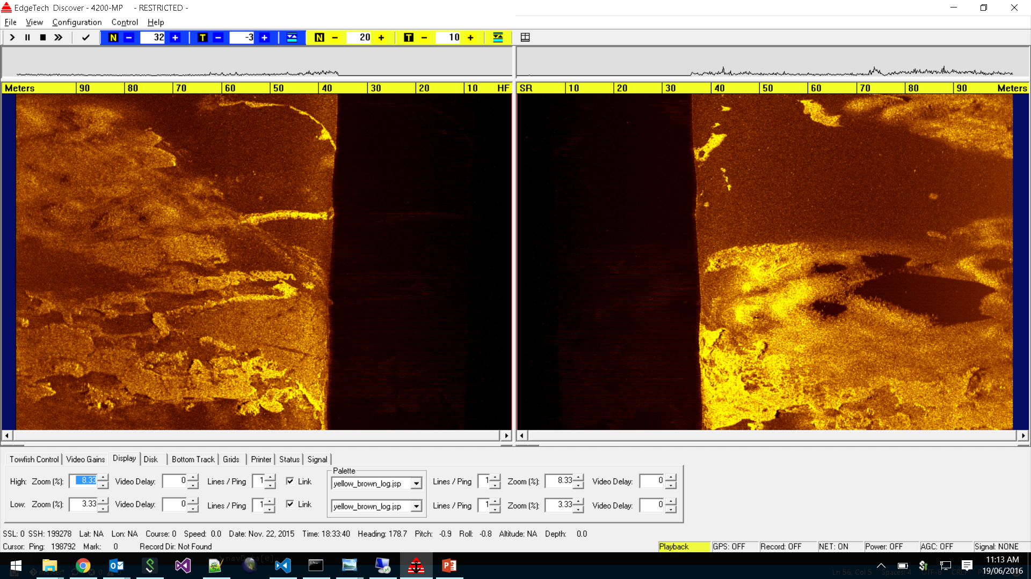
Yellow-Brown Logarithmic scale

Slide 3
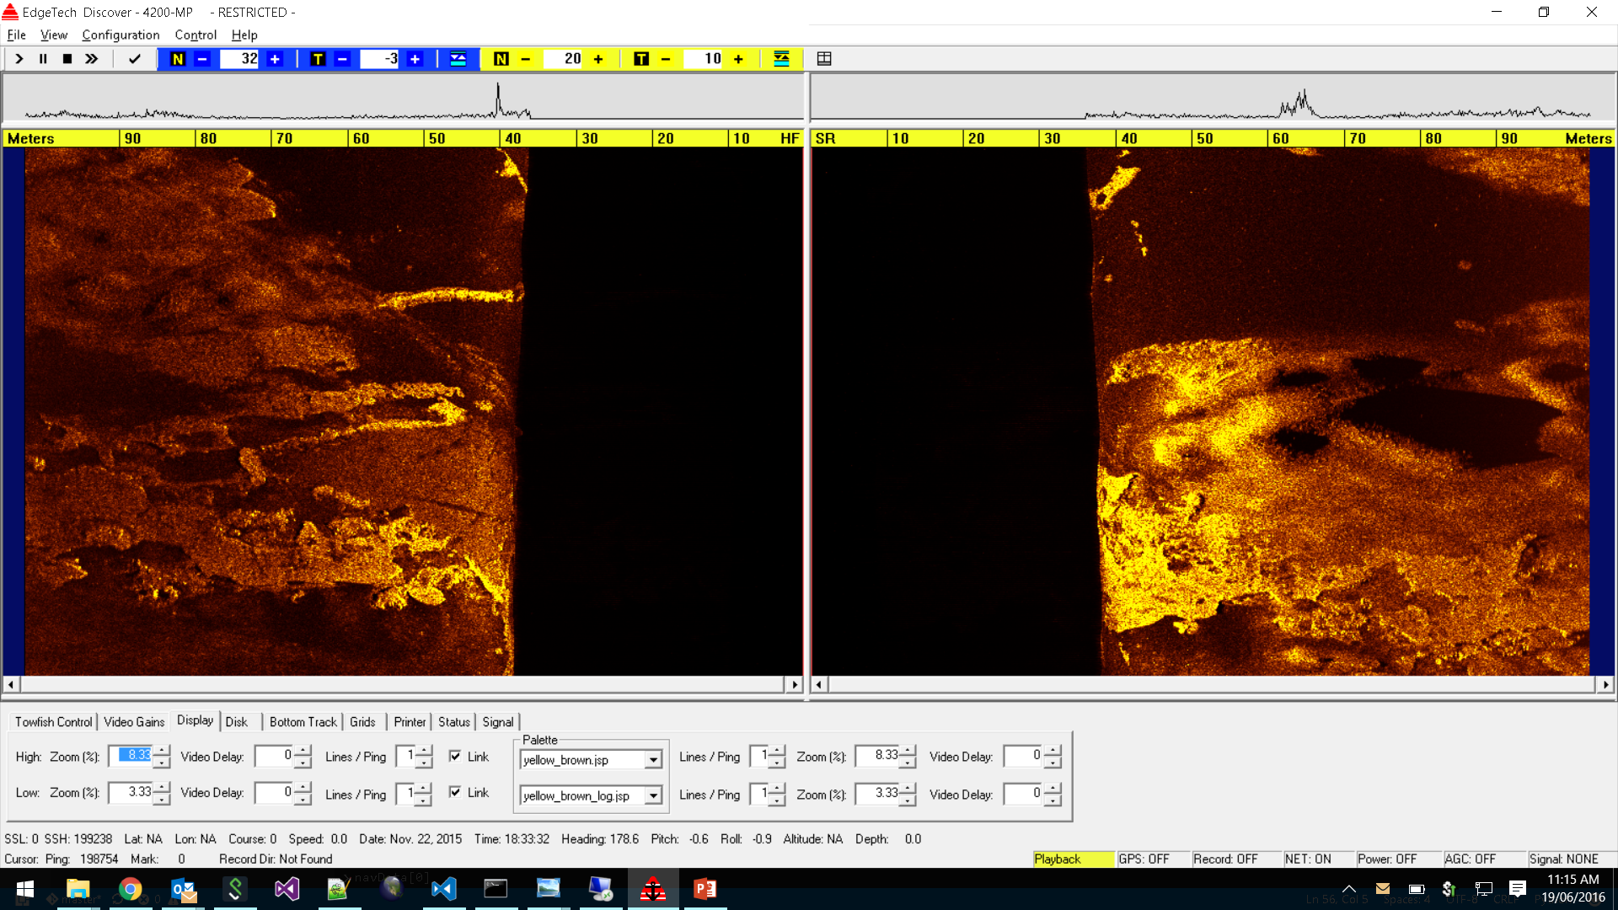
Yellow-Brown scale

Slide 4
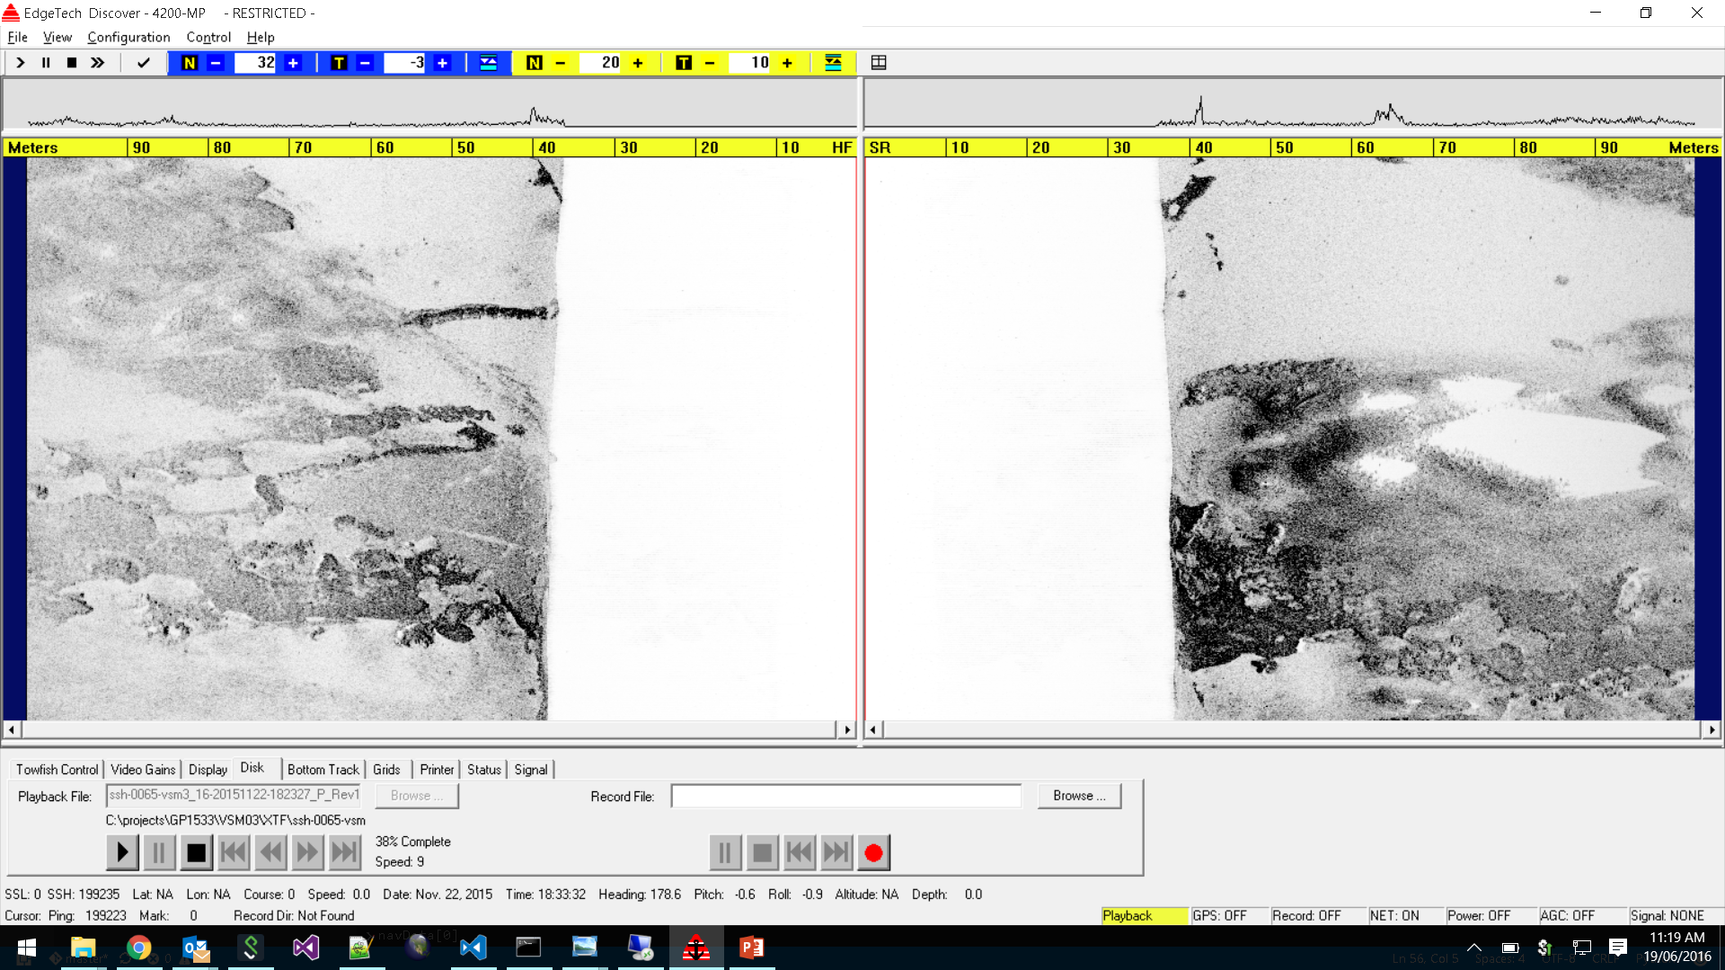
Discover Greyscale

Slide 5
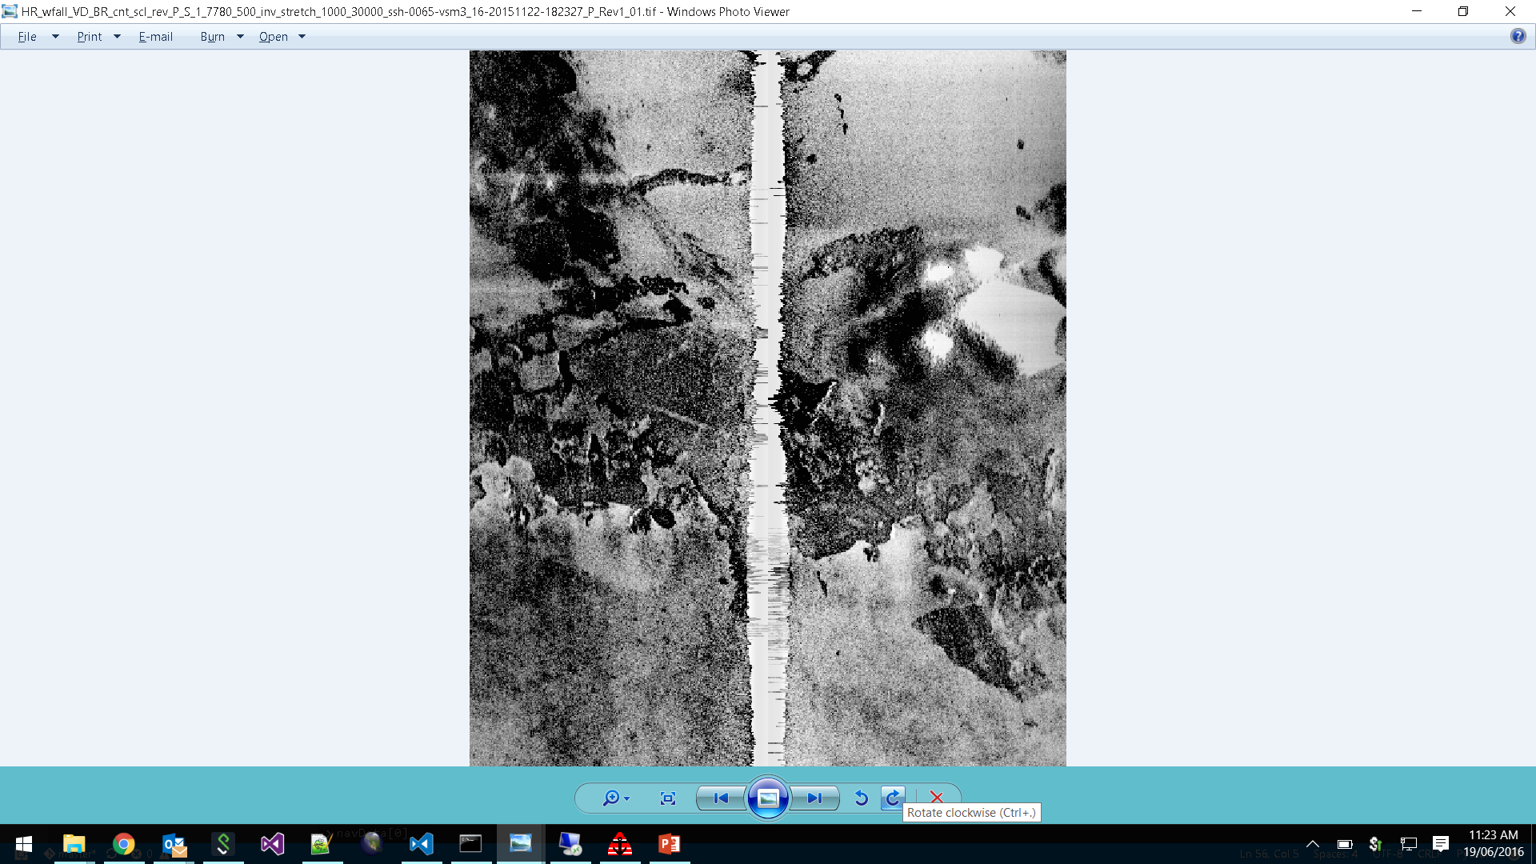
CSIRO Greyscale

Slide 6
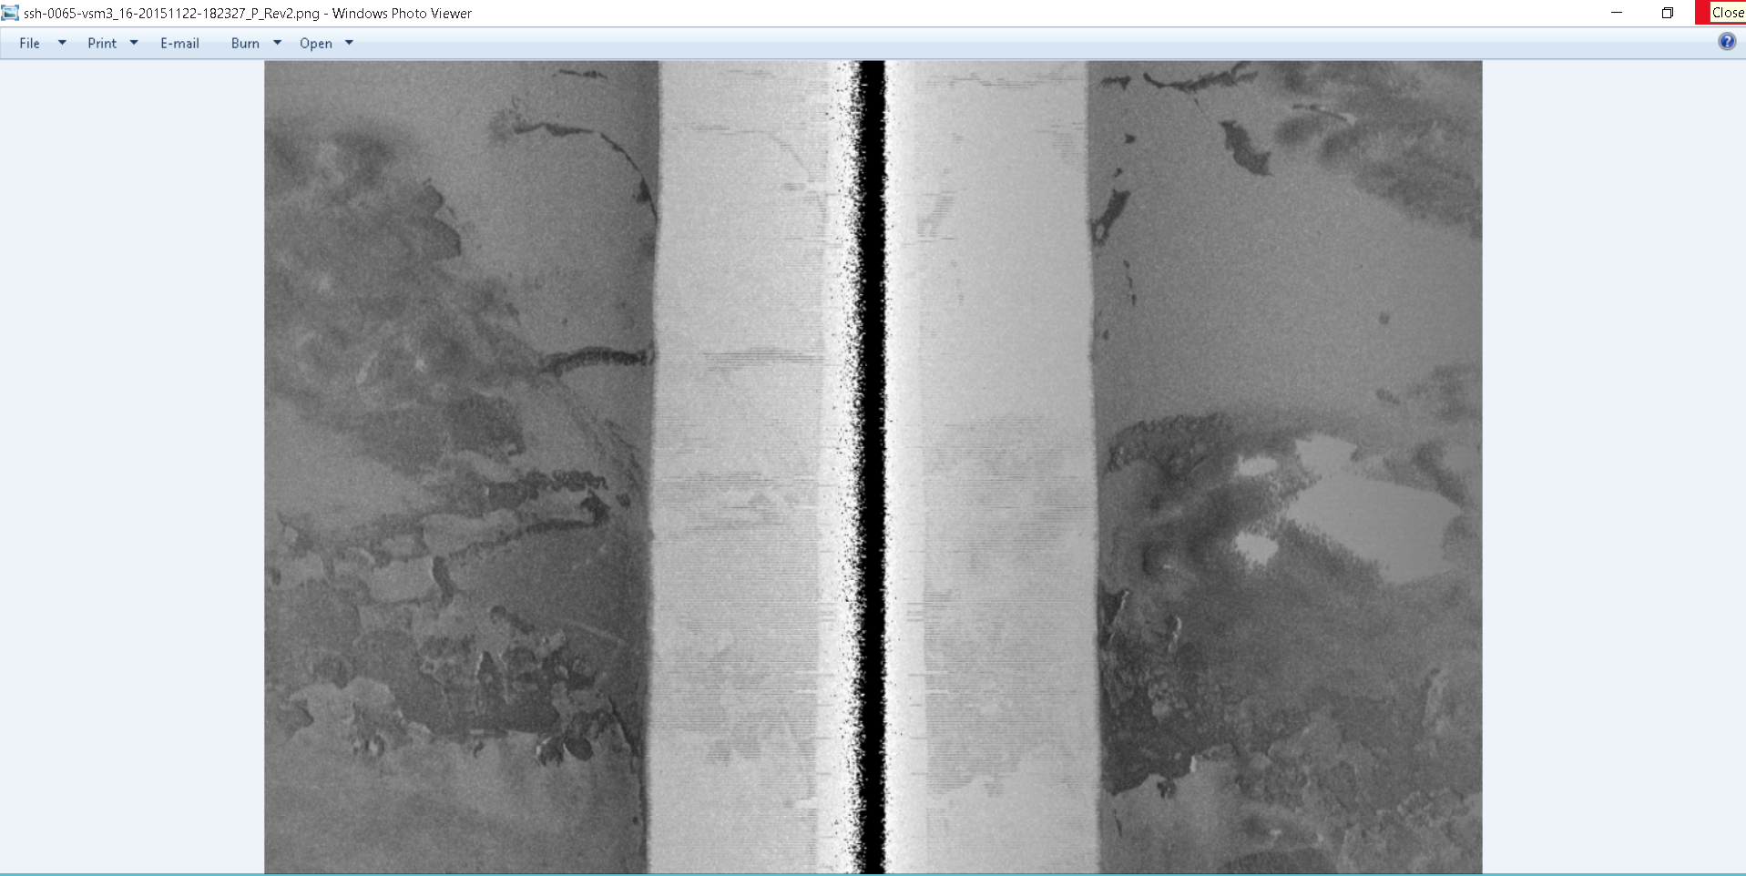
SonarBeamCorrection Gryscale Logarithmic

Slide 7
scale

Slide 8
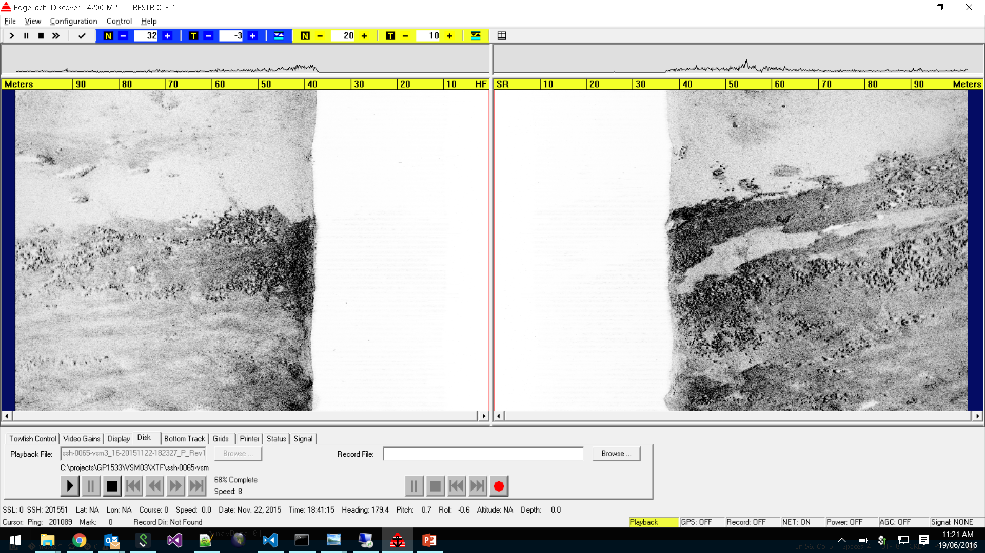
Discover Greyscale

Slide 9
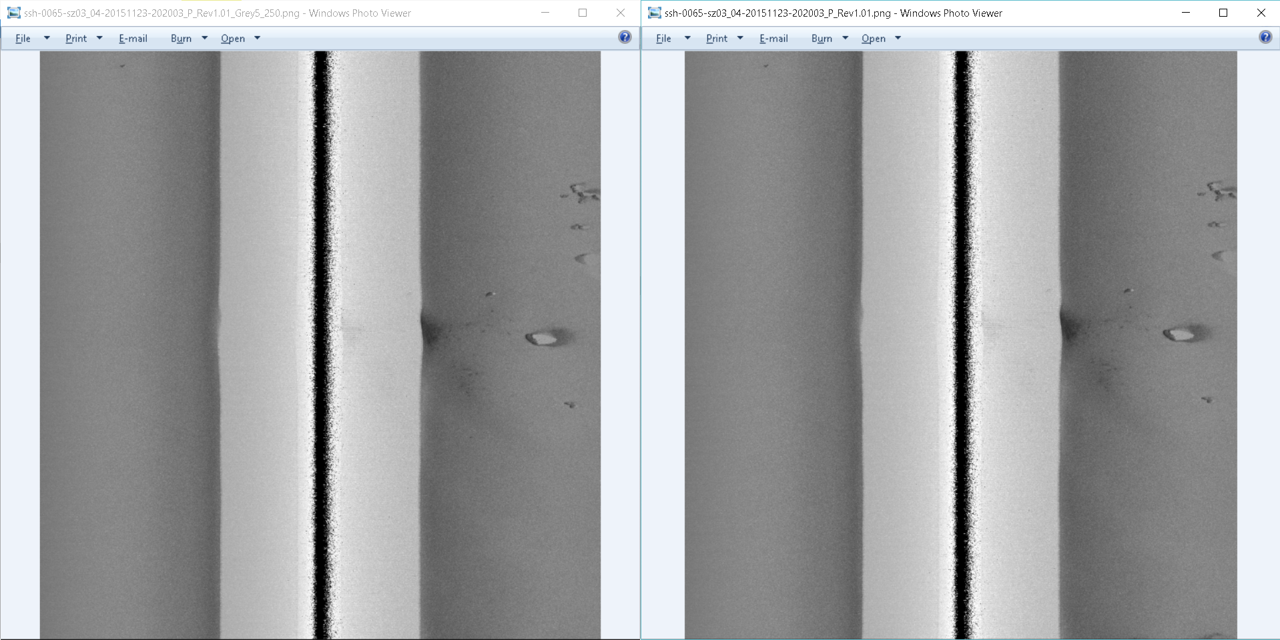
5/250 vs 0/255 grey scale

Slide 10
scale

Slide 11
scale

Slide 12
scale

Slide 13
scale

Slide 14
scale

